Slide 1
Renaming and Type Casting?
Explained for Beginners
What is Column Renaming?
What is Type Casting?
Why it’s important?
Let’s do some practice using python!
Sajjad Mustafa

Slide 2
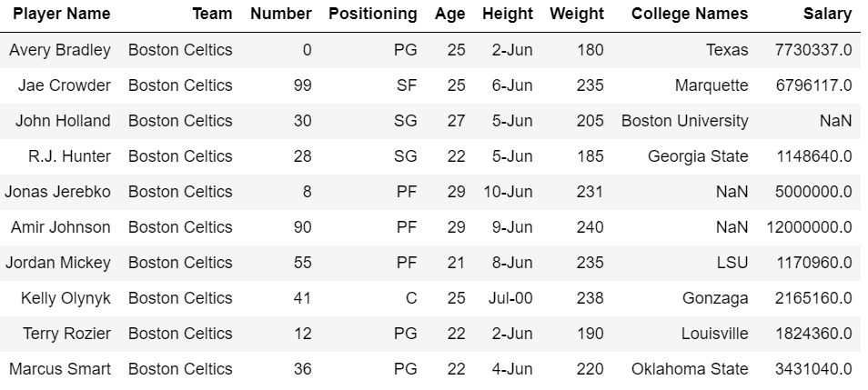
Type Casting

Slide 3
Column Renaming

Slide 4
Website : www.aisciences.io

